Slide 1
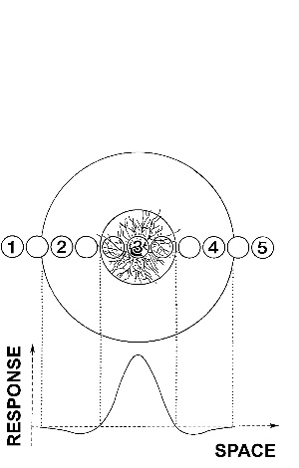
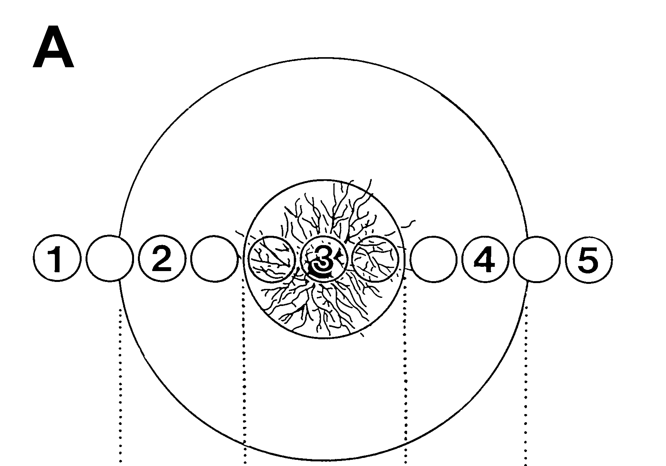
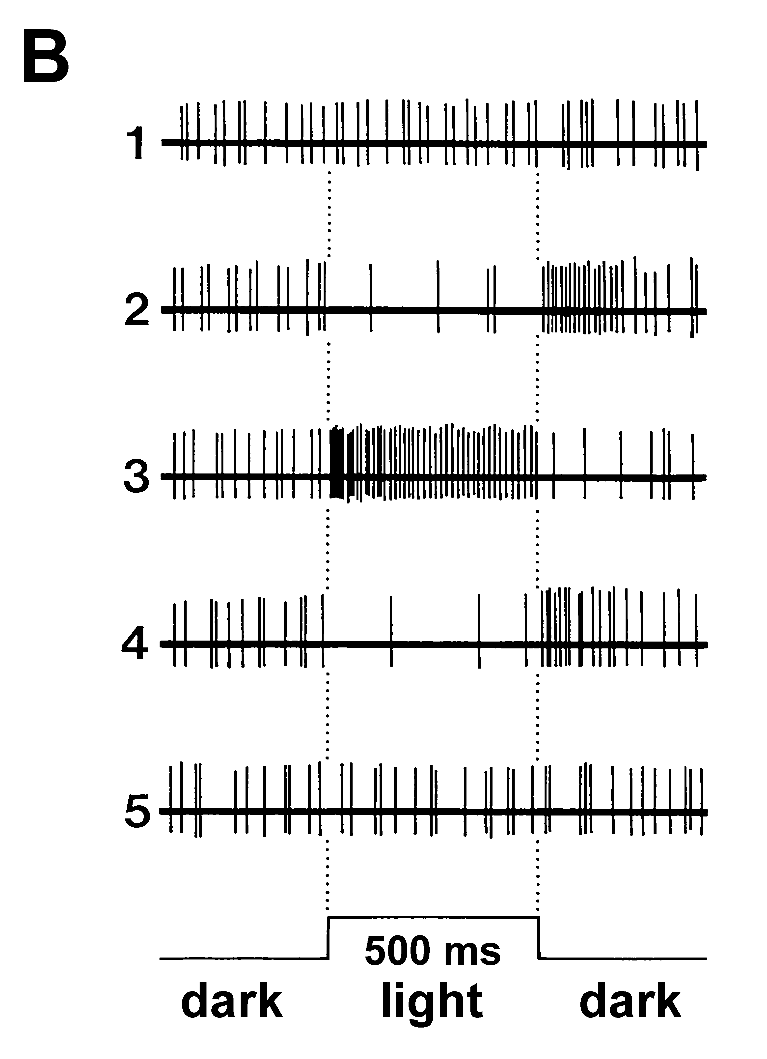
Receptive Field
Light-evoked
action potentials
Exc.
Center
V
V
t
500 ms
t
Inhibitory Surround

